Slide 1

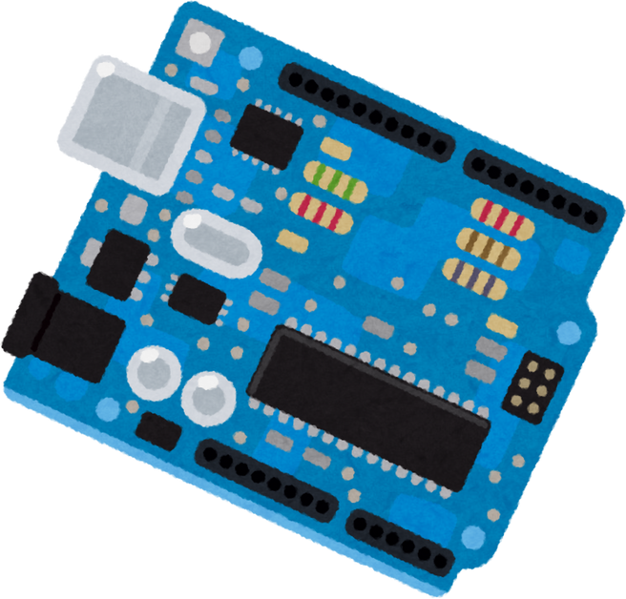






Graduation Project

Slide 2





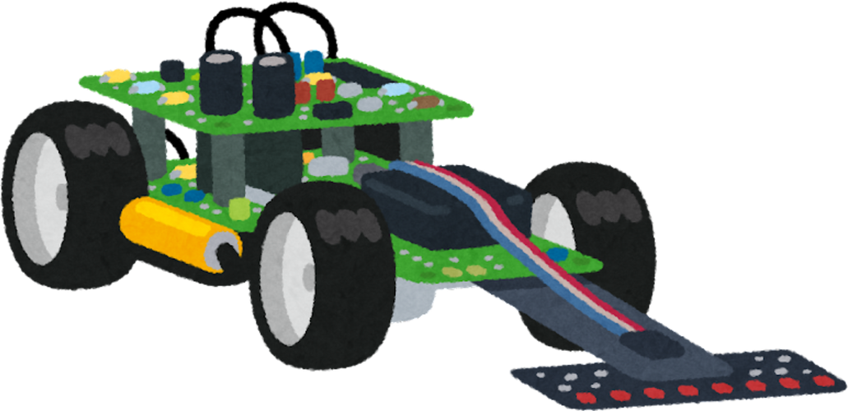

Graduation Project
Object Detection System
On Controlled Vehicle
Supervised by
Prof. Dr . Mohamed Fouad
Co-Supervision
Eng . Shady Bedier

Slide 3





Presented By
Mario Emad Edward CS
Omar Mohamed Ahmed CS
Moataz Ibrahim Gaber CS
Ali Farouk Ali CS
Nancy Khaled Sayed CS
Mohamed Eid Mahmoud IS
Yasmeen Mahdy Faheem IS

Slide 4




1. Introduction
3. Components Required
5. Circuit Diagram
6. Software App
7. Arduino Coding Platform
8. Object Detection System
10. Code
Design and Methodology:
18. Activity Diagram
19. Use Case Diagram
20. Sequence Diagram
21. Applications
24. Future Work
AGENDA

Slide 5
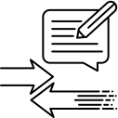

INTRODUCTION
- 1 -

Slide 6
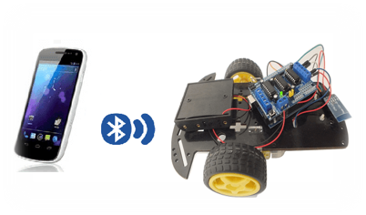
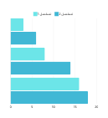
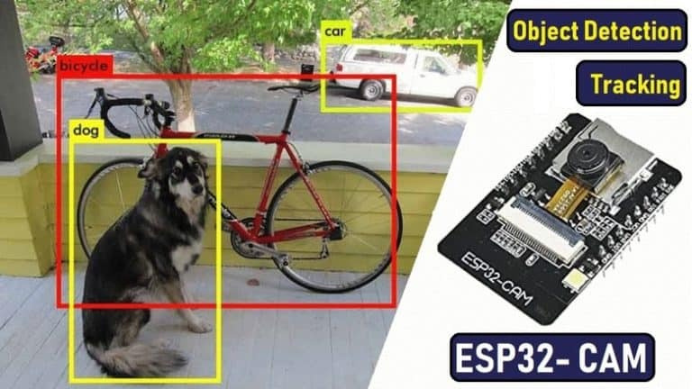
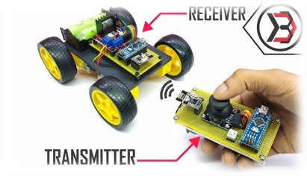


introduction
An Arduino car is a small robotic vehicle powered by an Arduino microcontroller. It's a popular project that combines electronics, programming, and mechanics to create a programmable and customizable vehicle, These projects are a great way to learn about robotics and hone programming skills in a hands-on manner
In this project, an Arduino-based car was built and equipped with an object detection camera. employs a camera for real-time object detection and live streaming. Controlled via a dedicated application, the car uses computer vision algorithms to identify many objects like Human, cell phone, chair and desk. This setup provides an excellent hands-on learning experience in integrating mobile app control with image processing and machine learning for robotics.
- 2 -

Slide 7





Components Required:
-
- 3 -

Slide 8
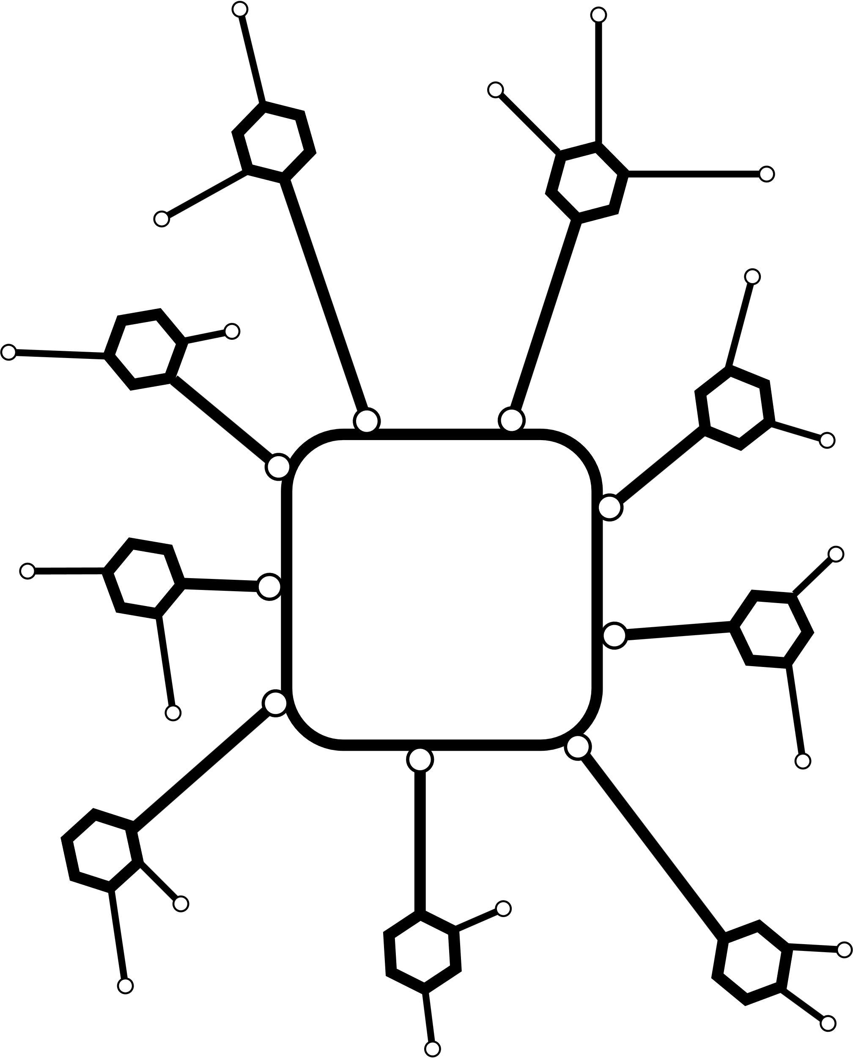
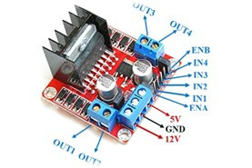
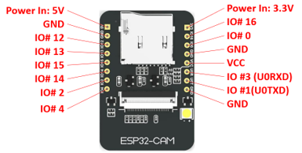
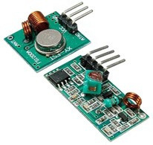
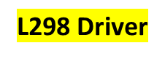
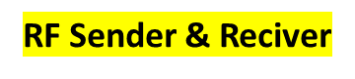
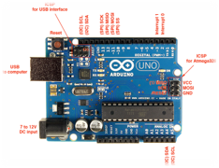
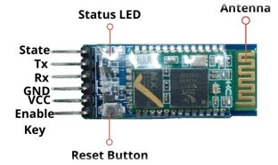
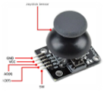
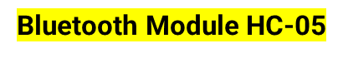


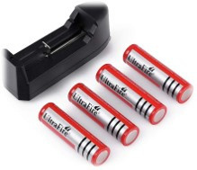
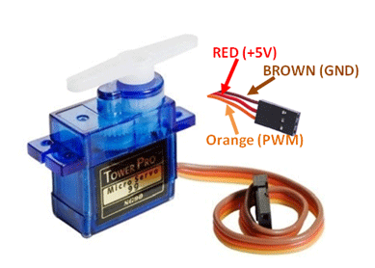
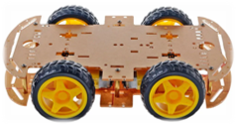
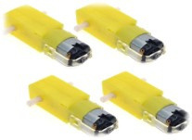
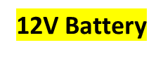

ESP – 32 Cam
Microcontroller
Car Kit
- 4 -
Servo Motor

Slide 9
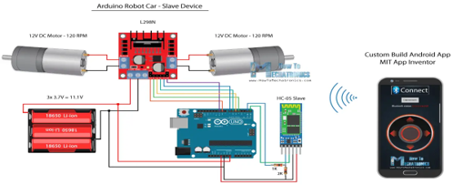
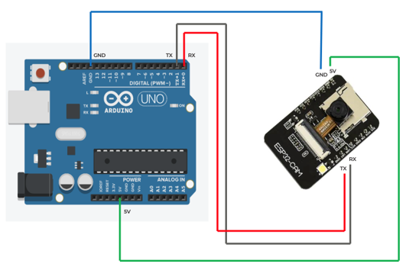
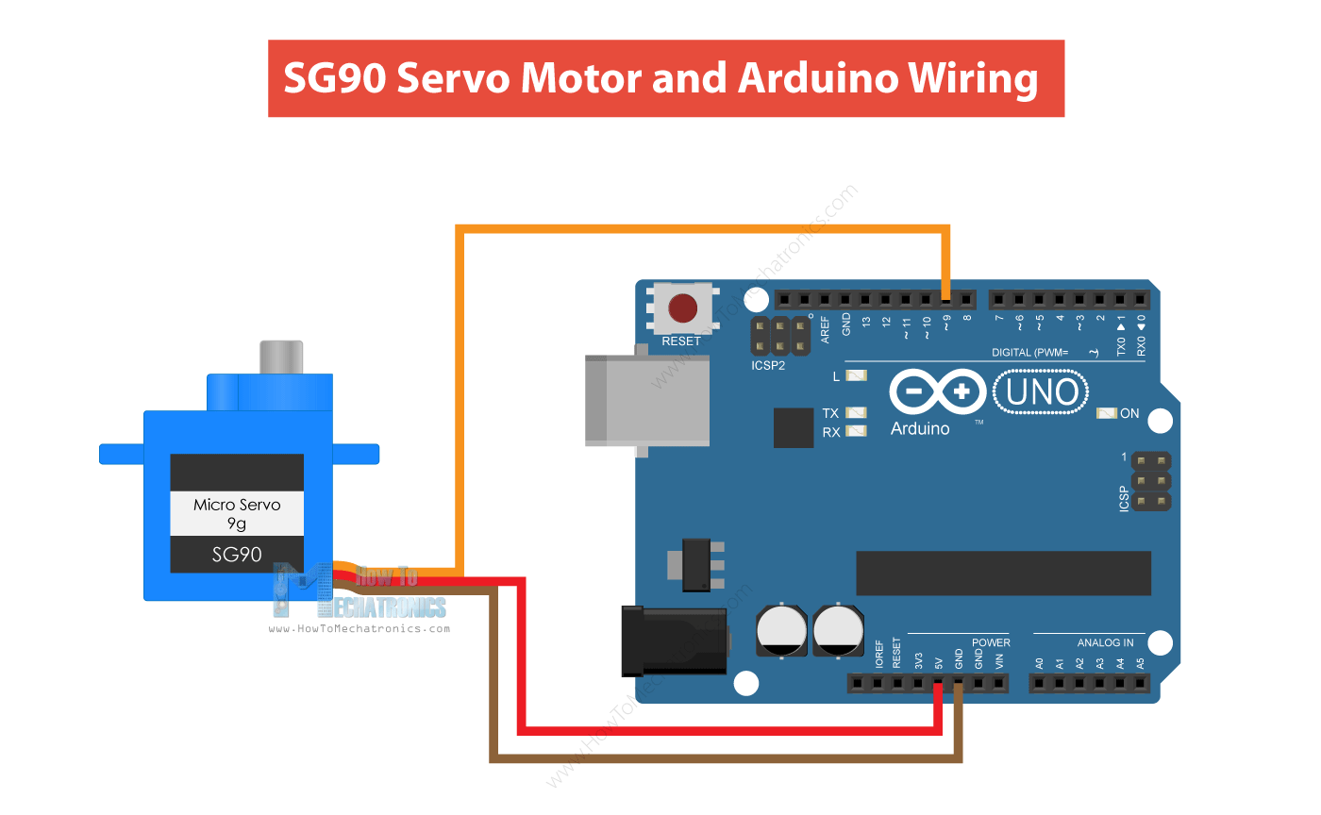
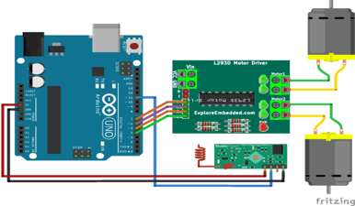
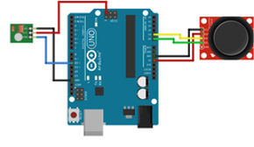
















Circuit Diagram:
- 5 -

Slide 10

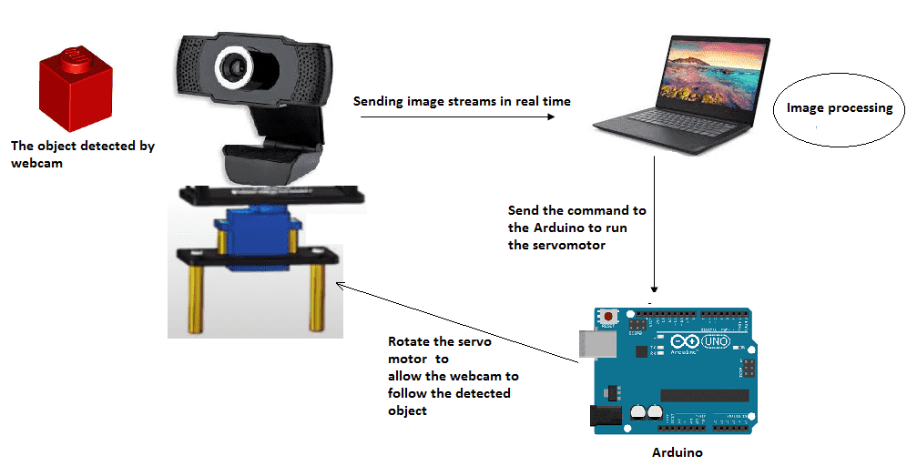










Detection Circuit:
implement command wifi and pass
Get ip address
Connected to camera
and servo movement
- 6 -

Slide 11


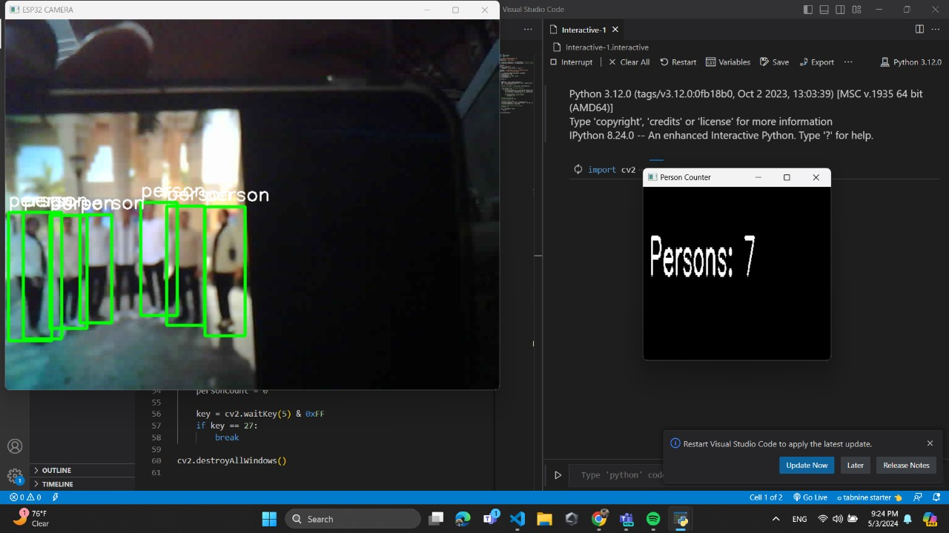
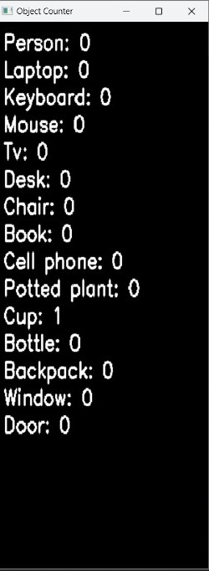
Live Stream Detection:
7
0
- 7 -

Slide 12
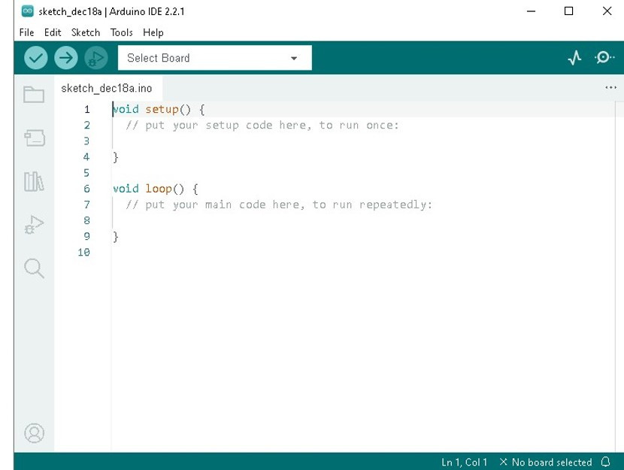
Arduino Coding Platform
- 8 -

Slide 13
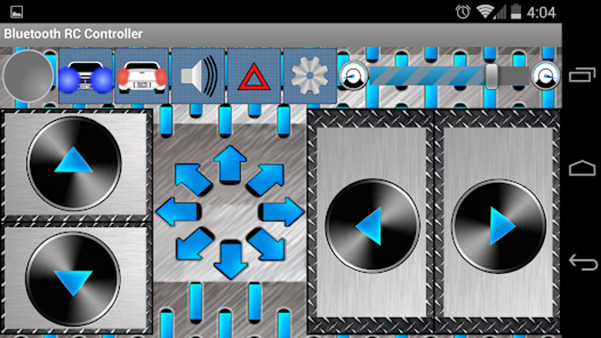
Bluetooth RC Controller Application:
- 9 -

Slide 14


Code
- 10 -

Slide 15
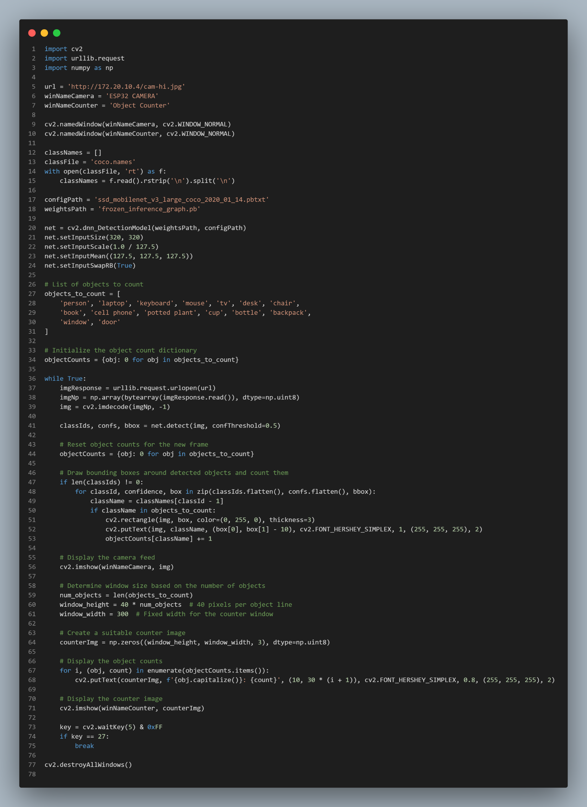
- 11 -

Slide 16
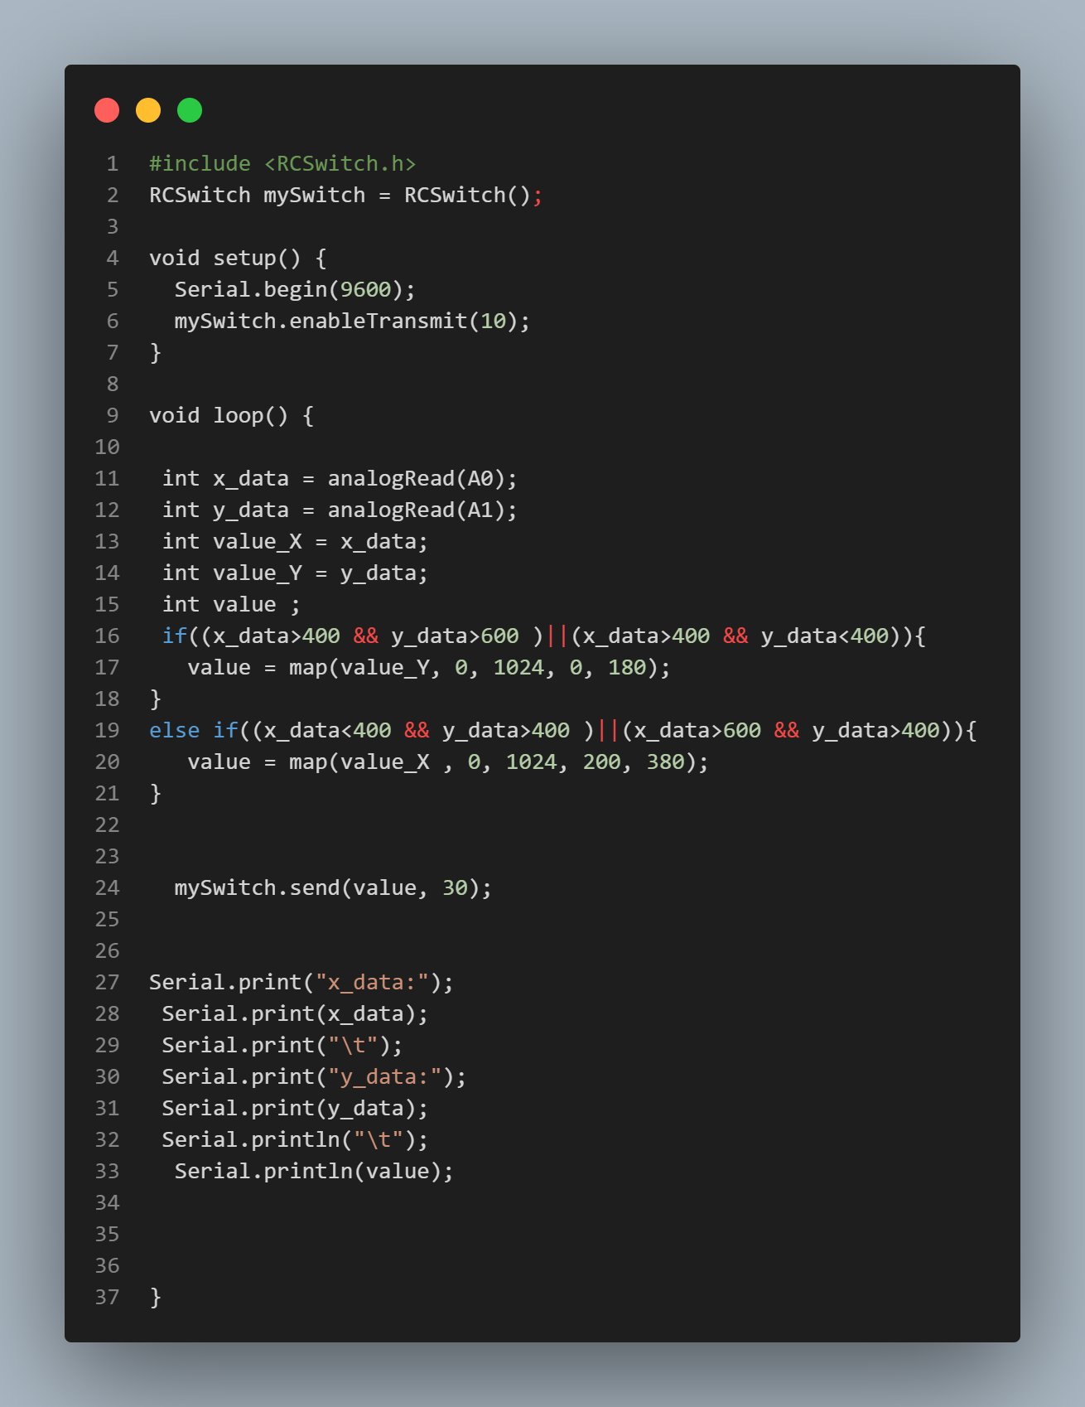
- 12 -
Notes:
20

Slide 17
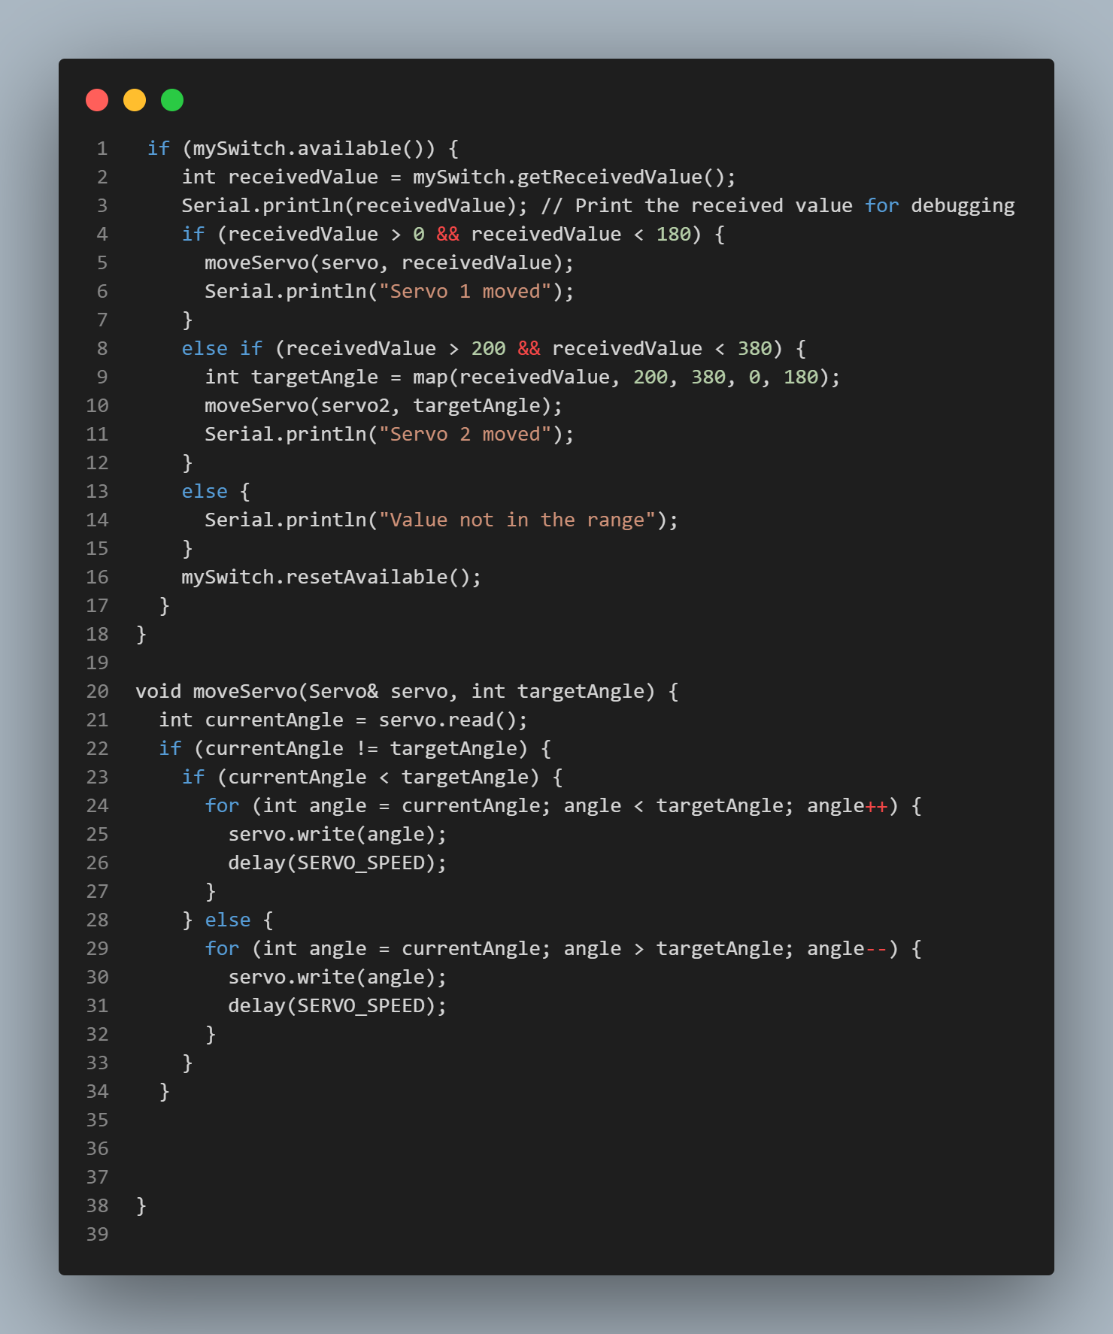
- 13 -

Slide 18
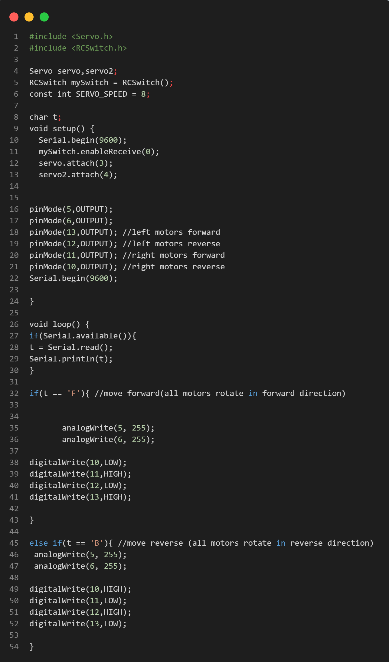
- 14 -
Notes:
20

Slide 19
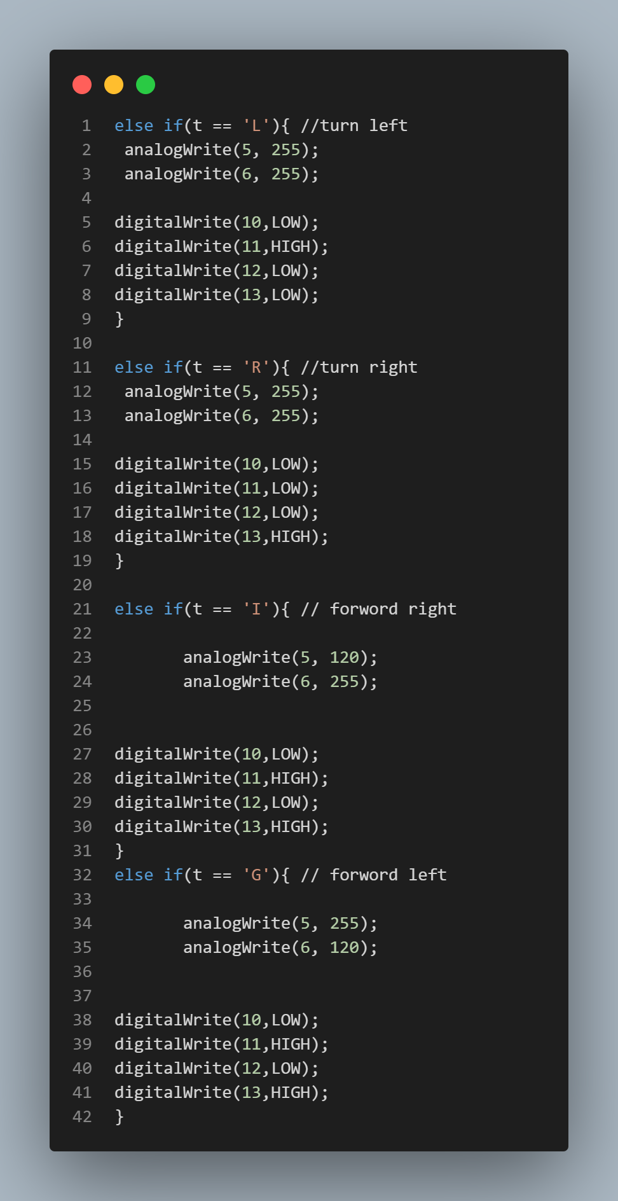
- 15 -
Notes:
20

Slide 20
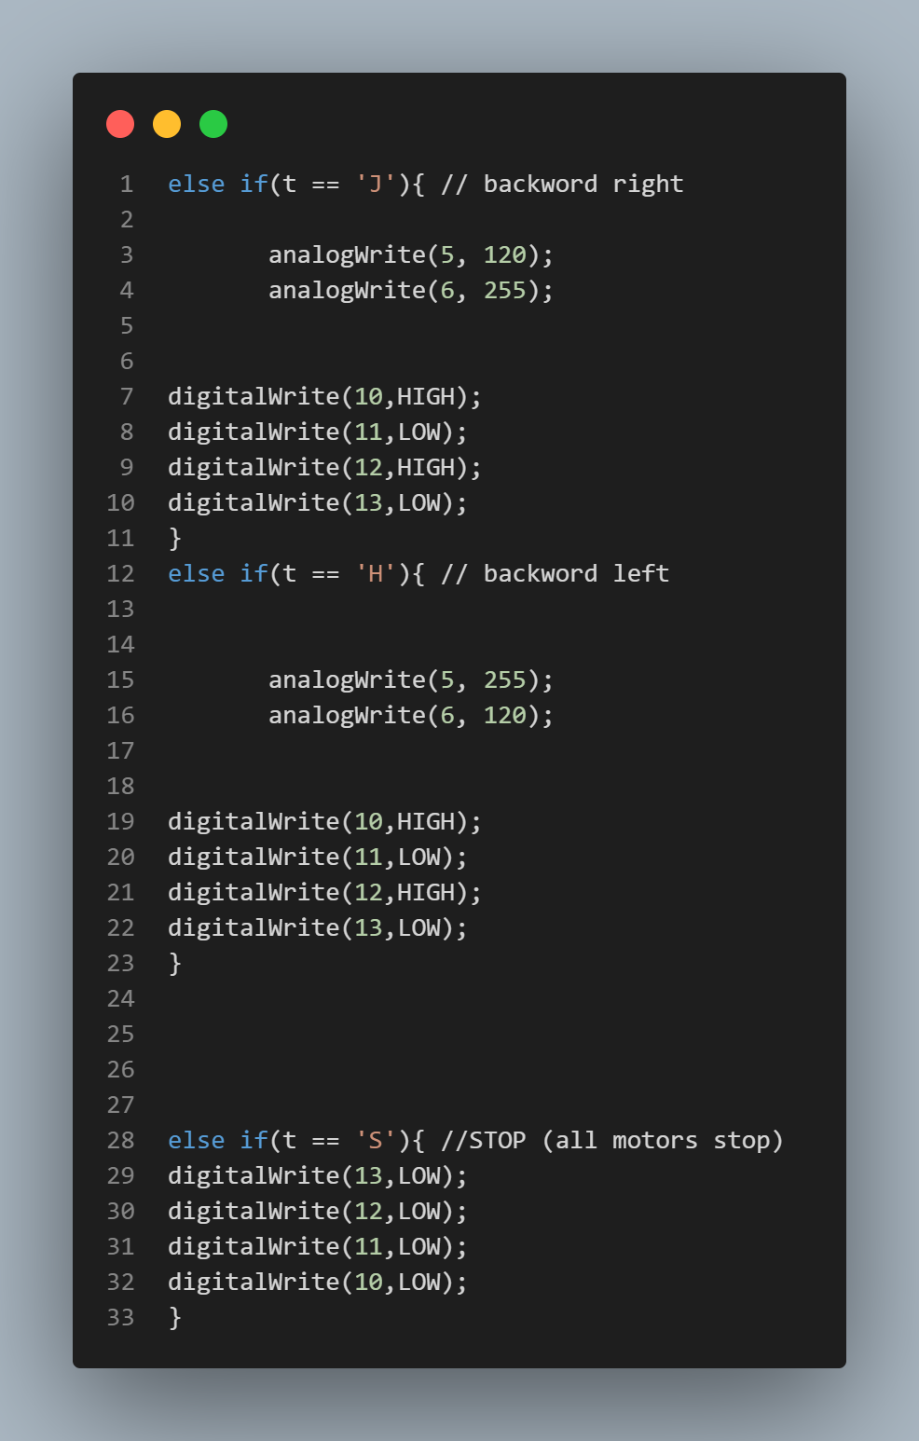
- 16 -
Notes:
20

Slide 21

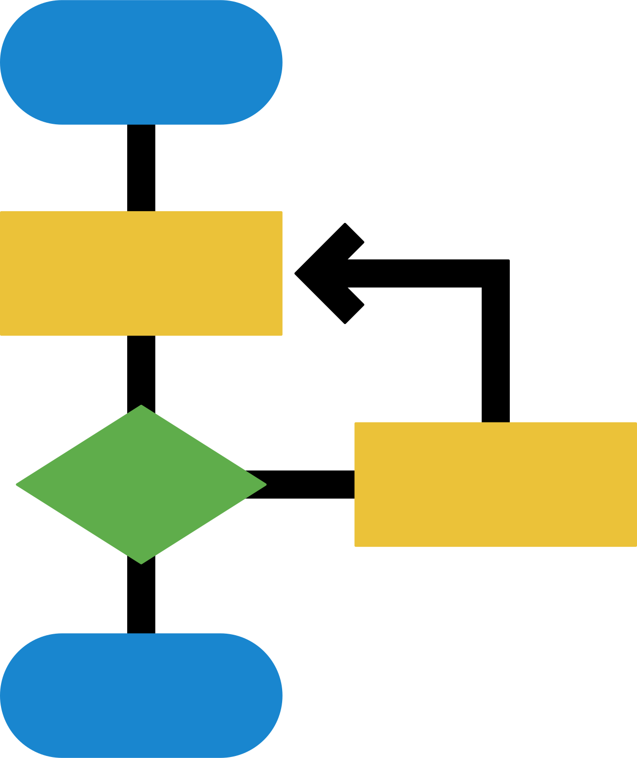

Design and Methodology
- 17 -

Slide 22
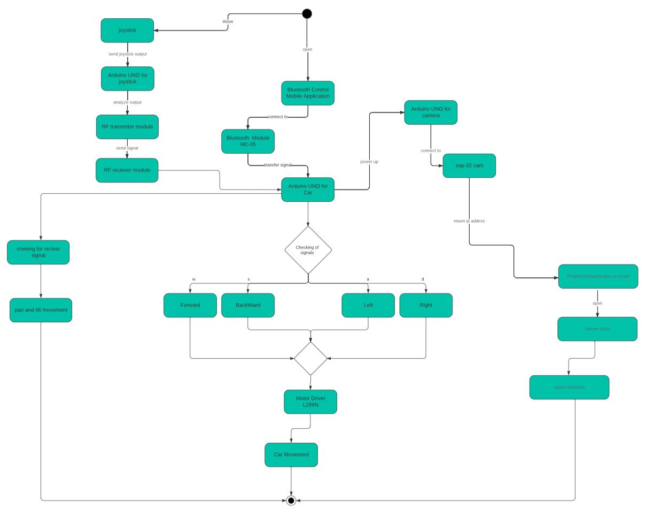
Activity Diagram
- 18 -

Slide 23
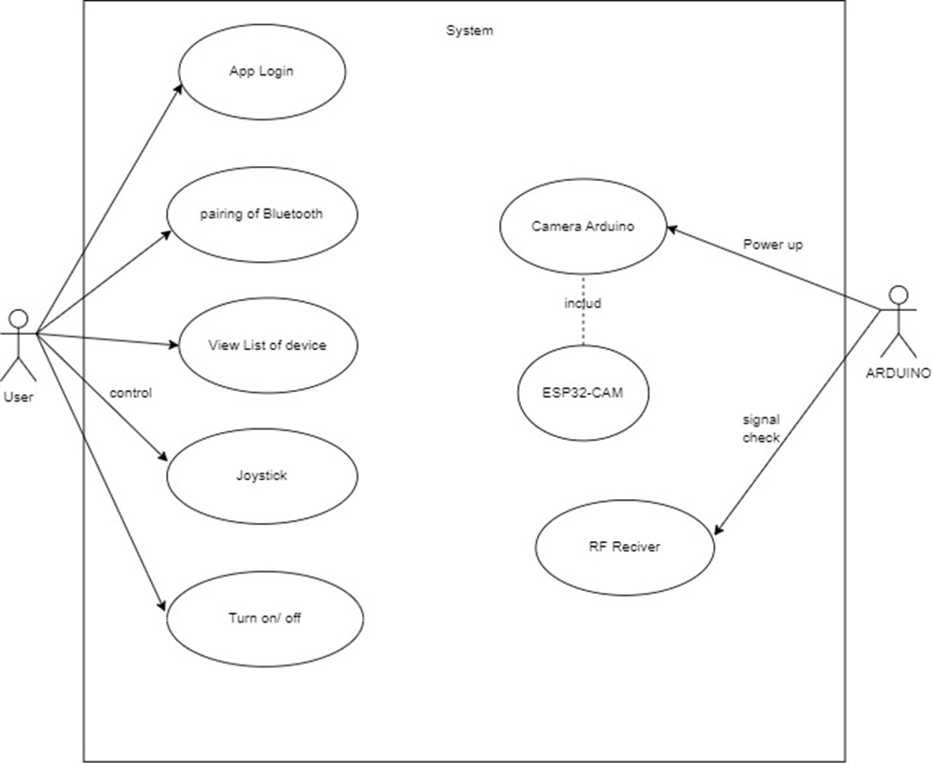
UseCase Diagram
- 19 -

Slide 24
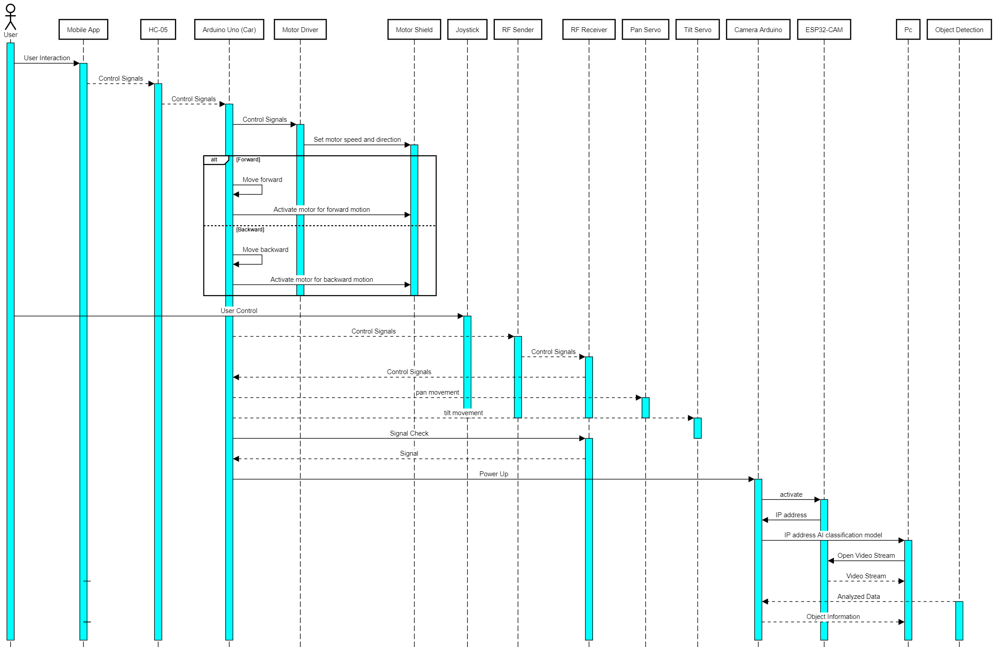
Sequence Diagram
- 20 -

Slide 25

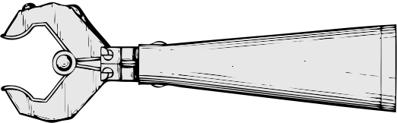

Applications
- 21 -

Slide 26
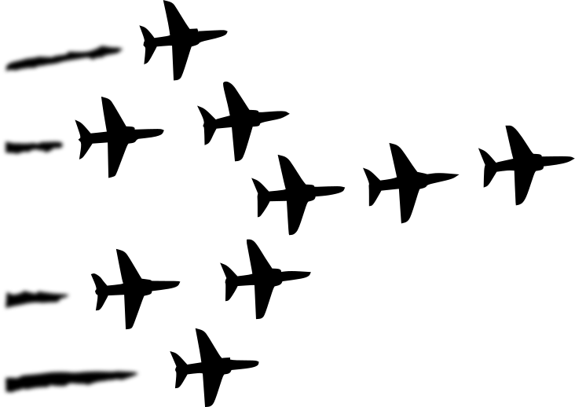
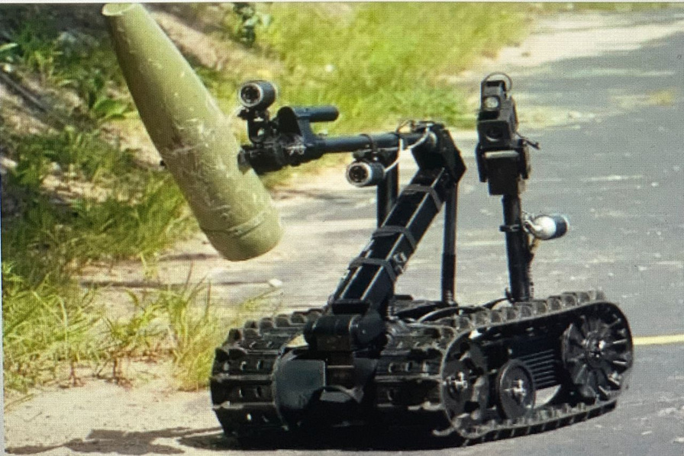
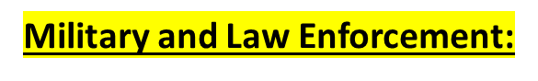
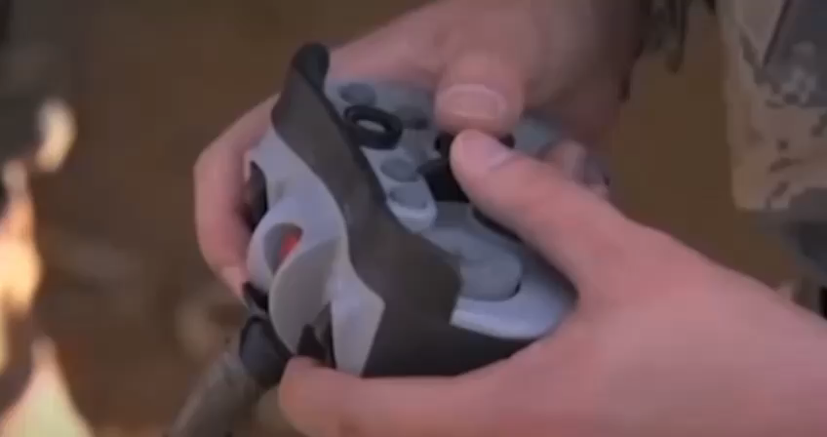

- 22 -

Slide 27
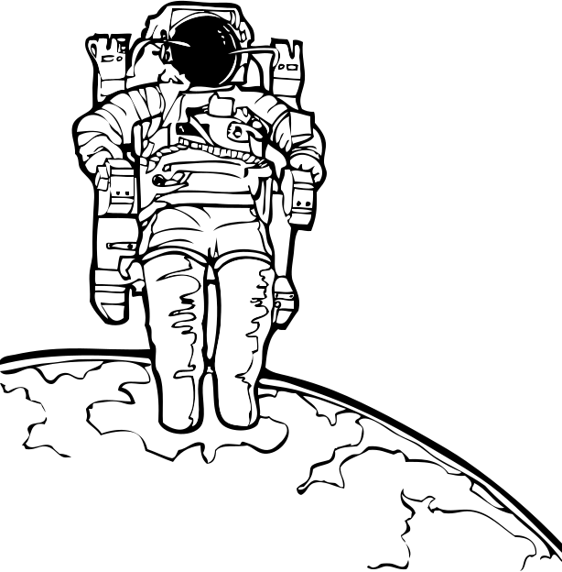
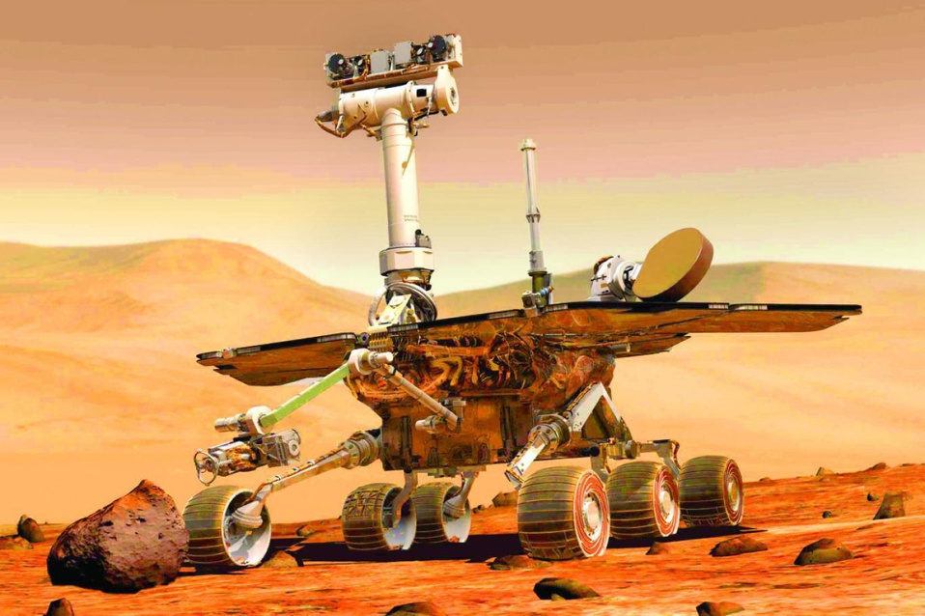

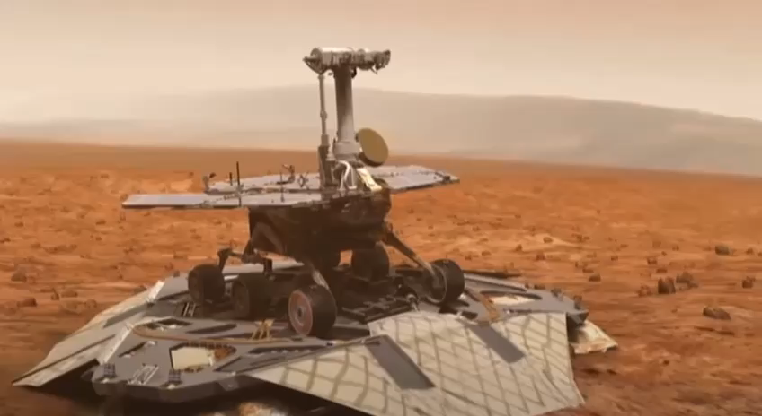

Space Exploration:
- 23 -

Slide 28
Future Work
- making application that offer live streaming ,car movement
and servo movement at the same time
- Incorporating additional Item “Raspberry Pi4”
for improving object detection system.
- Improved wireless communication protocols such as Wi-Fi 6 or
5G for more reliable and faster data transmission between the
vehicle and the control system
- Incorporating additional sensors like ultrasonic sensors, LiDAR,
or Infrared sensors can provide complementary data to enhance
object detection and navigation.
- 24 -

Slide 29





Omar Mohamed
ANY
QUESTIONS?
Mario Emad
Thank
You
Moataz Ibrahim
Ali Farouk
Mohamed Eid
Nancy Khaled
Yasmeen Mahdy

